Slide 1
Lab Meeting 2019/04/26
Explainable A.I (XAI)
Image Captioning
Visual Grounding

Slide 2
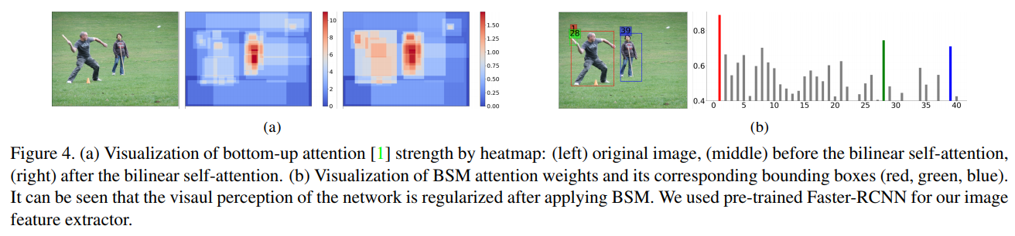
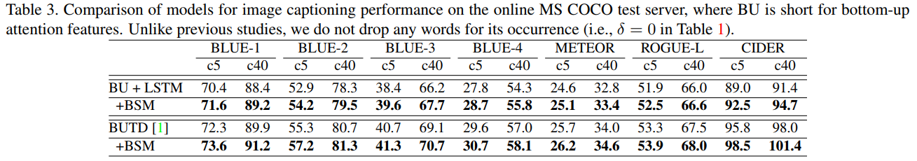
ICCV Submission

Slide 3
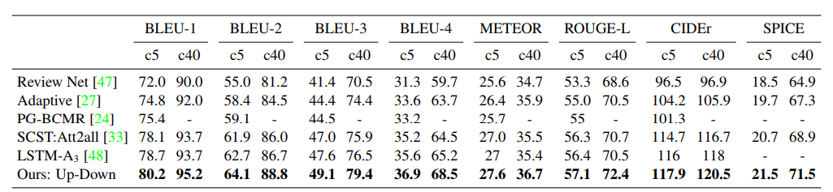

Image Captioning Society
$δ$=5
[1] Anderson, Peter, et al. "Bottom-up and top-down attention for image captioning and visual question answering." Proceedings of the IEEE Conference on Computer Vision and Pattern Recognition. 2018.

Slide 4
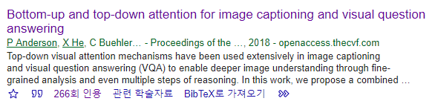
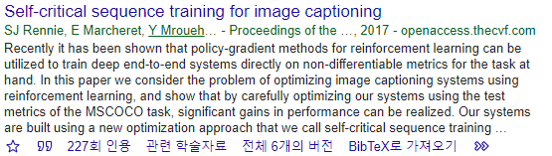
Research Goal
Follow-up the most recent (and SOTA) image captioning method
Understand and re-produce BUTD, the critical milestone.
Achieve insight in the model.
Understand the network in detail.
Re-produce self-critical sequence training (SCST) [2], another milestone in captioning.
[2] Rennie, Steven J., et al. "Self-critical sequence training for image captioning." Proceedings of the IEEE Conference on Computer Vision and Pattern Recognition. 2017.

Slide 5
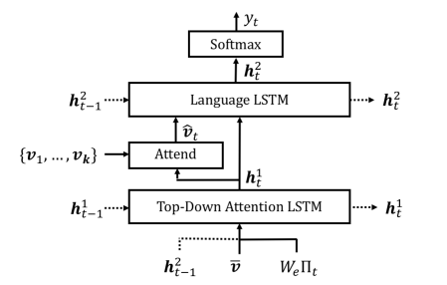
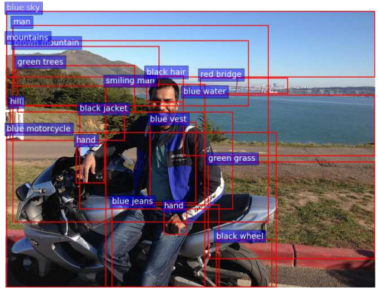

BUTD sturcture
Bottom-up features : from FASTER-RCNN
$\overline{v}:$Average of bottom-up features
$\left\{v_{1}, ⋯,v_{k}\right\}:$ Bottom-up features
$Π_{t}$: embedding of previous word

Slide 6
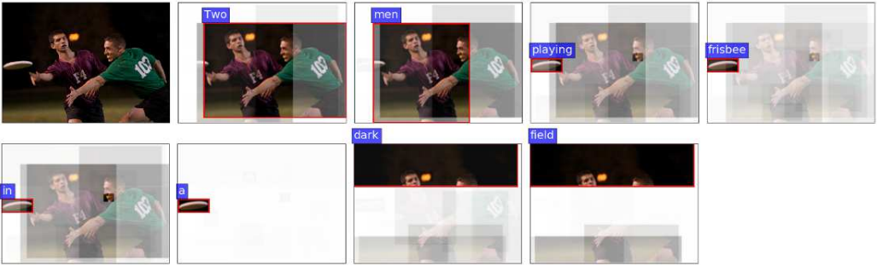



BUTD sturcture
=$\vec{0}$
$${\hat{v}}_{t}$$
=$\vec{0}$
$$Π_{t}$$
=$\vec{0}$
<sos>

Slide 7
BUTD sturcture
Two
$${\hat{v}}_{t}$$
$$Π_{t}$$
<sos>
$${\hat{v}}_{t}$$
Two

Slide 8
BUTD sturcture
men
$${\hat{v}}_{t}$$
$$Π_{t}$$
<sos>
Two
$${\hat{v}}_{t}$$
men

Slide 9
BUTD sturcture
playing
$${\hat{v}}_{t}$$
$$Π_{t}$$
<sos>
Two
men
playing
$${\hat{v}}_{t}$$

Slide 10
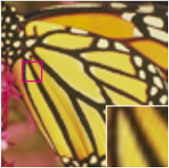

Self-Critical Sequence Training
Usually, Loss is directly related to evaluation metric
SR example (Loss: MSE, eval metric: PSNR)

Slide 11








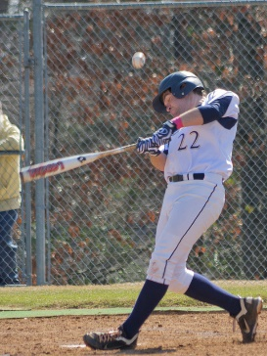






Self-Critical Sequence Training
3/20~4/14 (with beam-search)
Loss is MSE, while evaluaton is CIDEr
$$\vec{0}$$
CNN
$$[1×Vdim]$$
Linear
$$[1×Edim]$$
LSTM
LSTM
LSTM
LSTM
$$[1×Vdim]→[1×Edim]$$
emb
emb
emb
≪Encoder CNN≫
≪Decoder≫

Slide 12
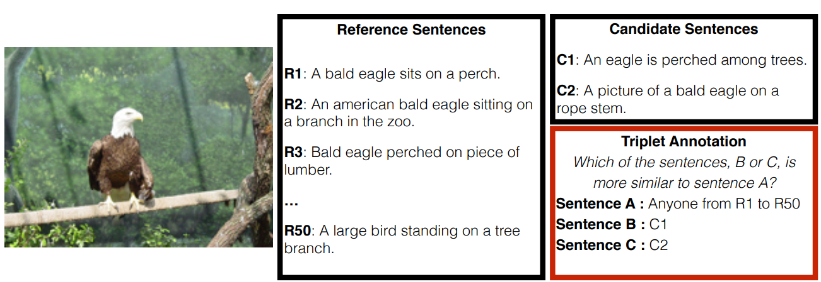
Self-Critical Sequence Training
CIDEr [3]
Consider numerous possible sentence style.
[3] Vedantam, Ramakrishna, C. Lawrence Zitnick, and Devi Parikh. "Cider: Consensus-based image description evaluation." Proceedings of the IEEE conference on computer vision and pattern recognition. 2015.

Slide 13



Self-Critical Sequence Training
Each word outputs are non-differentiable
Optimize for non-differentiable loss : Reinforcement learning
$${\hat{y}}_{i}=argmax( )$$
Softmax out
$$\left[\hat{y_{1}},\hat{y_{2}},⋯\hat{y_{N}}\right]$$
Decoder-lstm
*Non-differentiable

Slide 14
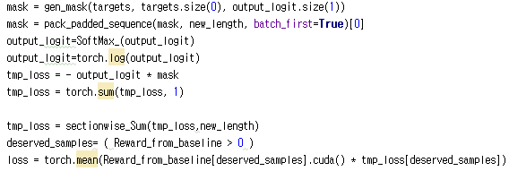

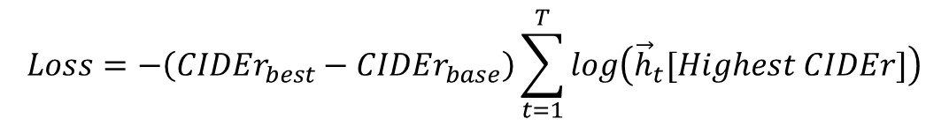

Self-Critical Sequence Training
Loss in SCST
Highest CIDEr
Maximum Probability
${\vec{h}}_{t}$=Softmax out
Decoder-lstm
$$\vec{h}$$
$$Loss=−\left({CIDEr}_{best}−{CIDEr}_{base}\right)\sum_{t=1}^{T}{log\left({\vec{h}}_{t}[Highest CIDEr]\right)}$$

Slide 15
Numerous Tips for learning (4/14~4/25)
Important tips for image captioning (+ other learning mechanisms)
1. <unk> word가 들어간 caption은 학습시 제외 시킬것 (noisy 한 성분을 포함하고 있는 data의 소거)
2. multilabe-margin loss를 이용하여서 중간부분을 바로 잡아주는것은 좋다.
3. 드랍아웃 사용할것, weight normalization 사용할 것
4. scheduling을 이용하여서 learning rate를 천천히 decay 시키는것은 좋다.
5. self-attention을 기본적인 cnn+lstm에다가 먼저 pre-train시킨 후, butd에 적용하는게 좋다(simple 구조에서의 self-attention을 먼저 학습한 후, 복잡한 구조에서의 self-attention 적용)

Slide 16





Multilabel Margin Loss
Very deep layer의 경우 (혹은 supervis가 weak하다가 판단되는 경우)중간에 기둥 역할 하는 loss computation stage 생성
Performance Improvement: 5~6%
output
Multi-label margin loss
input
$$⋯$$
$$⋯$$
output
Cross-Entropy Loss
$$≫$$
input
$$⋯$$
$$⋯$$
output
Cross-Entropy Loss

Slide 17
Learning-Rate Scheduling
Performance Improvement: 3~4%
Learning rate
0.001
Until convergence
Steps

Slide 18
Current Status
SCST reproduce : Done
BUTD reproduce : still lacks (about ~10%)
w/o SCST: 100.8 vs 114.1
With SCST: ???(training) vs 120.5

Slide 19
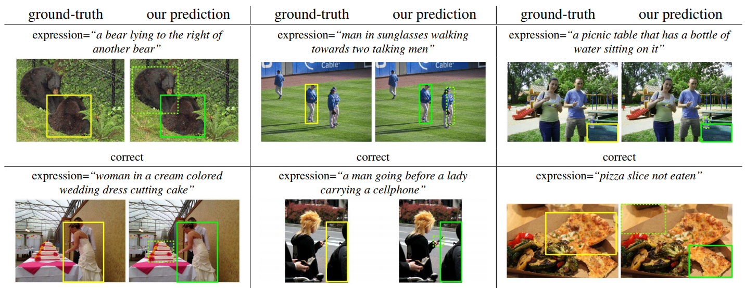
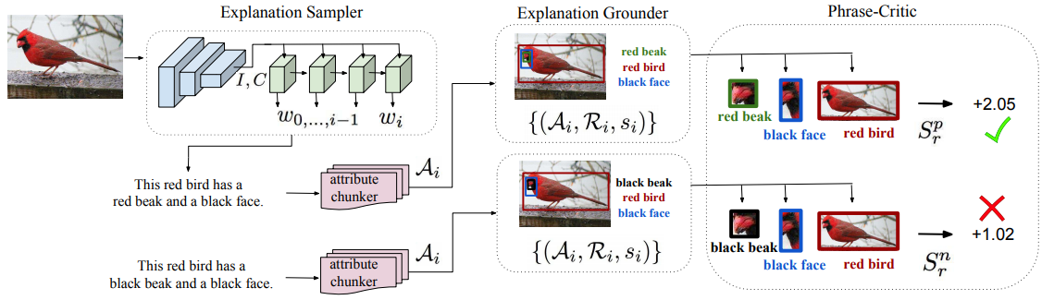
Schedule (modular network for visual grounding)
Implement [4], [5] in pytorch
Stepping stone to XAI project (for building objective metric)
[4] released in tensorflow, [5] no codes.
Objective metric for textual explanations => next paper topic
Keep debugging BUTD
[4] Hu, Ronghang, et al. "Modeling relationships in referential expressions with compositional modular networks." Proceedings of the IEEE Conference on Computer Vision and Pattern Recognition. 2017.
[5] Anne Hendricks, Lisa, et al. "Grounding visual explanations." Proceedings of the European Conference on Computer Vision (ECCV). 2018.

Slide 20
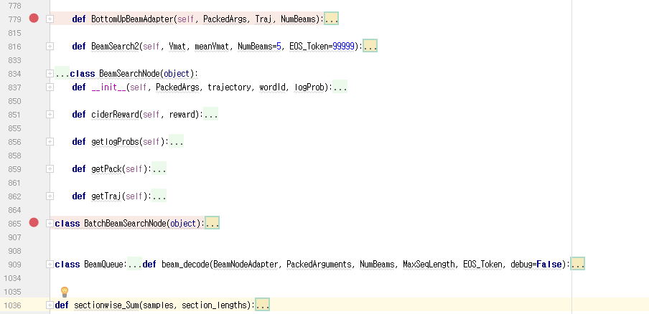
Appendix
Beamsearch codes

Slide 21
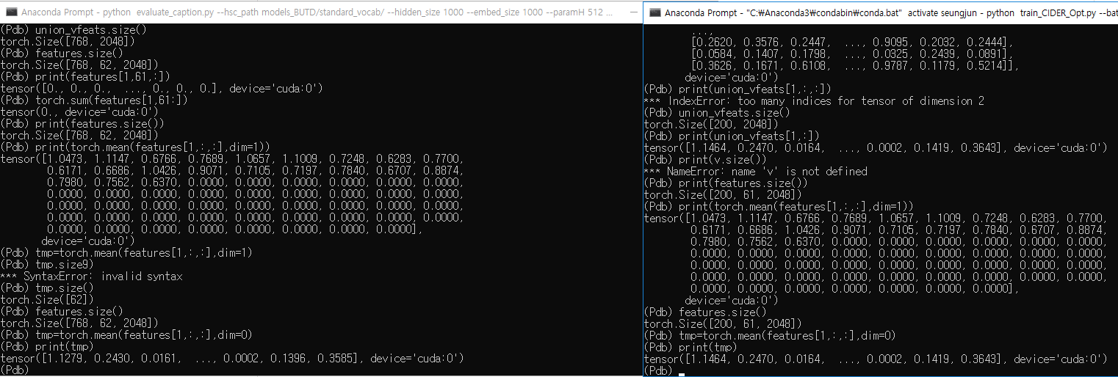
Debug (5/1)
Debug for image captioning
가장 기본적인 문제 발견: [10 to 100] bottom-up pretrain 사용시
Collate_fn으로 인하여 batch_size를 다르게 하면 각 샘플에 할당되는 object 개수가 달라지며, 이로 인하여 각 샘플(faster-rcnn으로 뽑은) feature의 mean값이 달리진다!

Slide 22
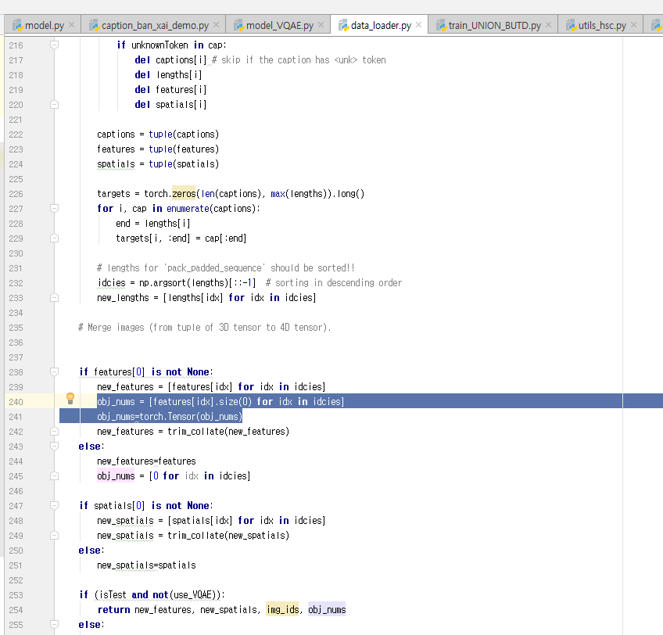
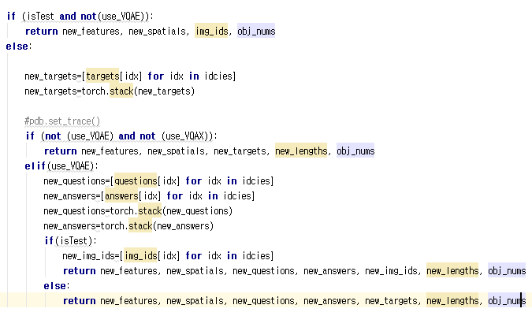
Debug - Solution (5/1)
trim_Collate 하기전 샘플마다의 object 개수를 저장하고 같이 리턴한다.

Slide 23


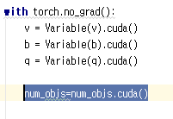
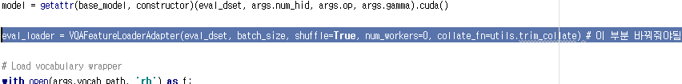
Debug-solution
Xai 관련 코드에서 수정 사항들: (예: caption_ban_xai_demo.py)

